Slide 2
Introduction to Programming PROG101

Slide 3
Week 3 Python standards, Input, Outputs, and Variables

Slide 4
Outlines
Anatomy of a Python Program
Programming Style and Documentation
Use inputs and outputs
Programming Errors
Literals
Variables and Constants

Slide 5
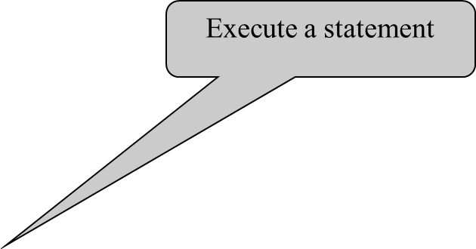
A Simple Python Program
Listing 1.1
# Display two messages
print("Welcome to Python")
print("Python is fun")

Slide 6
Trace a Program Execution
# Display two messages
print("Welcome to Python")
print("Python is fun")

Slide 7
Two More Simple Examples
WelcomeWithThreeMessages
ComputeExpression

Slide 8
Anatomy of a Python Program
Statements
Comments
Indentation

Slide 9
Statement
A statement represents an action or a sequence of actions. The statement print("Welcome to Python") in the program in Listing 1.1 is a statement to display the greeting "Welcome to Python“.
# Display two messages
print("Welcome to Python")
print("Python is fun")

Slide 10
Indentation
The indentation matters in Python. Note that the statements are entered from the first column in the new line. It would cause an error if the program is typed as follows:
# Display two messages
print("Welcome to Python")
print("Python is fun")

Slide 11
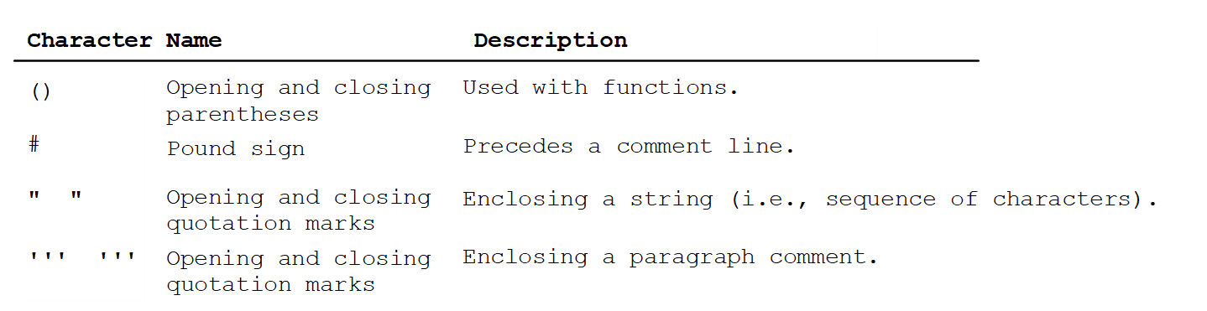
Special Symbols

Slide 12
Programming Style and Documentation
Appropriate Comments
Proper Indentation and Spacing Lines

Slide 13
Appropriate Comments
Include a summary at the beginning of the program to explain what the program does, its key features, its supporting data structures, and any unique techniques it uses.
Include your name, class section, instructor, date, and a brief description at the beginning of the program.

Slide 14
Proper Indentation and Spacing
Indentation
Indent four spaces.
A consistent spacing style makes programs clear and easy to read, debug, and maintain.
Spacing
Use blank line to separate segments of the code

Slide 15
Programming Errors
Syntax Errors
Error in code construction
Runtime Errors
Causes the program to abort
Logic Errors
Produces incorrect result

Slide 16
Literals
Numeric literals
Literal: any element of data specified for a program
Numeric literal: one or more digits that can represent integers or floating-point numbers containing a decimal point
Sample numeric literals: dwarf_rings = 7 1 ring_thickness = 2.7

Slide 17
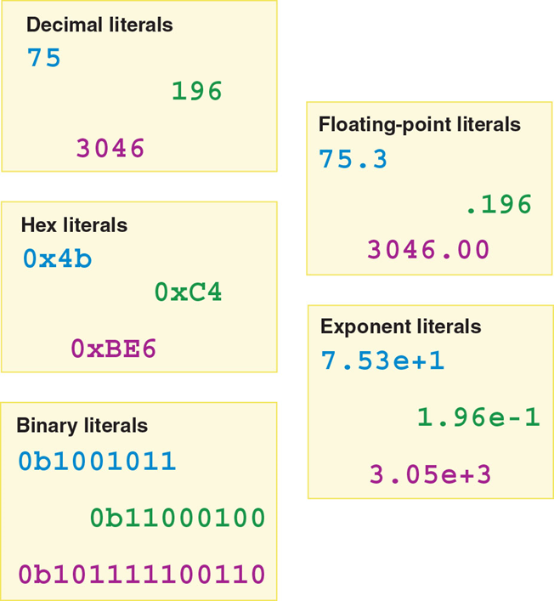
Literals
Common numeric literals

Slide 18
Literals
Character and string literals
Character literal: a single letter or symbol
Sample character literals: 'a' '@'
String literal: value containing one or more characters; typically denoted with double quotes
Sample string literals: "Mordor" "Three rings for the elven kings..." "bilbo@theshire.com"

Slide 19
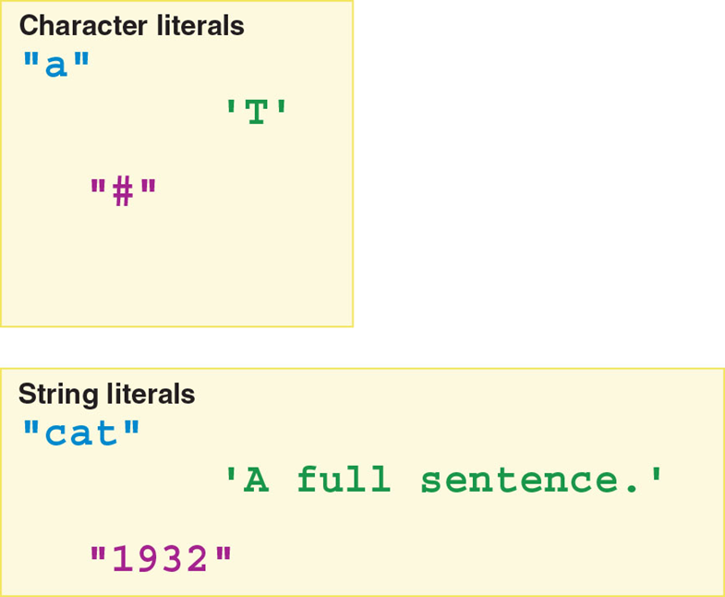
Literals
Character literals and string literals

Slide 20
Literals
Tricky literals
Literals containing number characters can be either numbers or strings
When working with numerals in a context where they are not manipulated mathematically, you can enclose them in double or single quotes to designate them as strings
Example use cases: area codes, PINs, Social Security numbers
Boolean literal: a literal with a value of either True or False that is not a string, and thus not enclosed in quote marks
Example use case: setting a fact as true

Slide 21
Primitive Data Types
Data types
Data type: a way of categorizing data
Primitive data types
Primitive data types are built into a programming language
Programming language knows how to allocate memory for storing these data types
Programming language knows how to manipulate that type of data
Function: a named procedure that performs a specific task, such as manipulating data

Slide 22
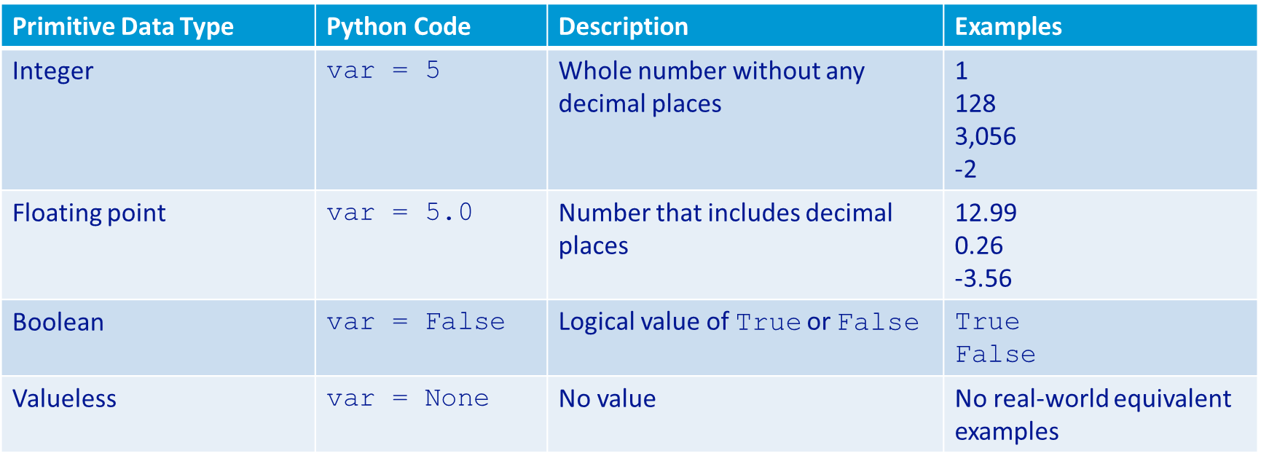
Primitive Data Types

Slide 23
Numeric Data Types
Integer data types
Whole numbers are classified as integer data types
Must be whole numbers without decimal places or fractions
Can be positive or negative
Unsigned integers don't have a plus or minus symbol and are assumed to be positive
Signed integers begin with a plus or minus symbol
Can be a decimal, binary, or hexadecimal number
Examples:
23 is an unsigned integer
-40 is a negative signed integer
0b00000101 is an unsigned integer (binary 5)
0x6C is an unsigned integer (hexadecimal 108)

Slide 24
Numeric Data Types
Composite data types
Composite data types are not built into programming language, but can be constructed from primitive data types
Programmer defined or available in add-on libraries of program code

Slide 25
Numeric Data Types
Integer data types
Whole numbers are classified as integer data types
Must be whole numbers without decimal places or fractions
Can be positive or negative
Unsigned integers don't have a plus or minus symbol and are assumed to be positive
Signed integers begin with a plus or minus symbol
Can be a decimal, binary, or hexadecimal number
Examples:
23 is an unsigned integer
-40 is a negative signed integer
0b00000101 is an unsigned integer (binary 5)
0x6C is an unsigned integer (hexadecimal 108)

Slide 26
Numeric Data Types
Floating-point data types
Numbers with decimal places (i.e., a decimal point and values to the right of it) are classified as floating-point data types
Can be positive or negative
Can be expressed in decimal notation or E notation
Examples:
19.99 is an unsigned floating-point number
-4.5967E2 is a signed floating-point number in E notation
Single precision: refers to four-byte floating-point numbers
Double precision: refers to eight-byte floating-point numbers
All floating-point numbers in Python are double precision, inferred from the decimal point in the assignment statement, e.g., price = 5.99

Slide 27
Variables and Constants
Variables
Variable: a named memory location that temporarily holds text or a numeric value
Variables have three important characteristics:
A name
A corresponding memory location where data can be stored
Changeable (mutable) data

Slide 28
Variables and Constants
Variables (continued)
General variable naming conventions
In Python, you cannot use the name of one of the language's built-in functions, such as print
Names should be descriptive
Python variable names must start with a letter or an underscore
Two most prevalent conventions for combining words for variable names:
Camel case begins with a lowercase letter, but each subsequent word is capitalized
Snake case uses all lowercase and separates words with an underscore
Python typically uses camel case for variable names

Slide 29
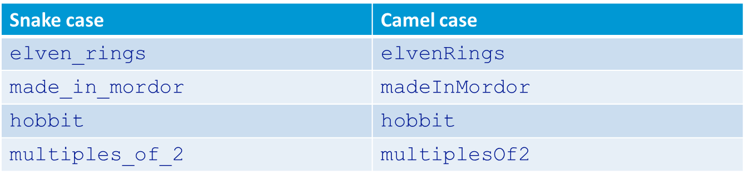
Variables and Constants

Slide 30
Variables and Constants
Constants
Constant: a named memory location that holds data, which is used but not changed by the statements in a program
Important characteristics of constants:
A name
A corresponding memory location where data can be stored
Data that is not meant to be changed
General constant naming conventions:
Should be descriptive
Python convention is to name constants in all uppercase text with an underscore separating words

Slide 31
Variables and Constants
Constants (continued)
Sample Python constants: MINUTES_IN_HOUR = 60 MAXIMUM_USERS = 1024 OHIO_ABBREVIATION = "OH"
Using constants for formulas facilitates easier code changes/maintenance
The memory connection
Both variables and constants correspond to memory locations where data can be stored
These memory locations have unique addresses, expressed in binary or hex numbers
When you specify the name for a variable or constant, your programming language ties it to a memory location (the address) where you can put data

Slide 32
Variables and Constants
Declaring variables
Using an undefined variable produces a runtime error, so it is essential to define the variables used in programs
To declare a variable means specifying a name that is assigned, or bound, to a memory location
Python requires you to assign a value to all variables with an initialization statement while declaring them
Initializing variables
To initialize a variable means specifying a name and a value
Dynamically typed: describes a programming language (such as Python) that allows a variable to take on any type of data during program execution
Type inference: process in which a language deduces the data type based on the presence or absence of a decimal point and quote marks

Slide 33
Variables and Constants
Initializing variables (continued)
In a dynamically typed language, a variable can repeatedly be reassigned to a value of a different data type (e.g., changed from an integer to a string)
Statically typed: describes a programming language that requires you to store only one type of data in a variable
Roles of initialization in programming
Specifying starting values when known
Specifying the initial value of a repetition counter (typically 0 or 1)
Creating a null variable (one that has no value), which is assigned to the keyword None in Python

Slide 34
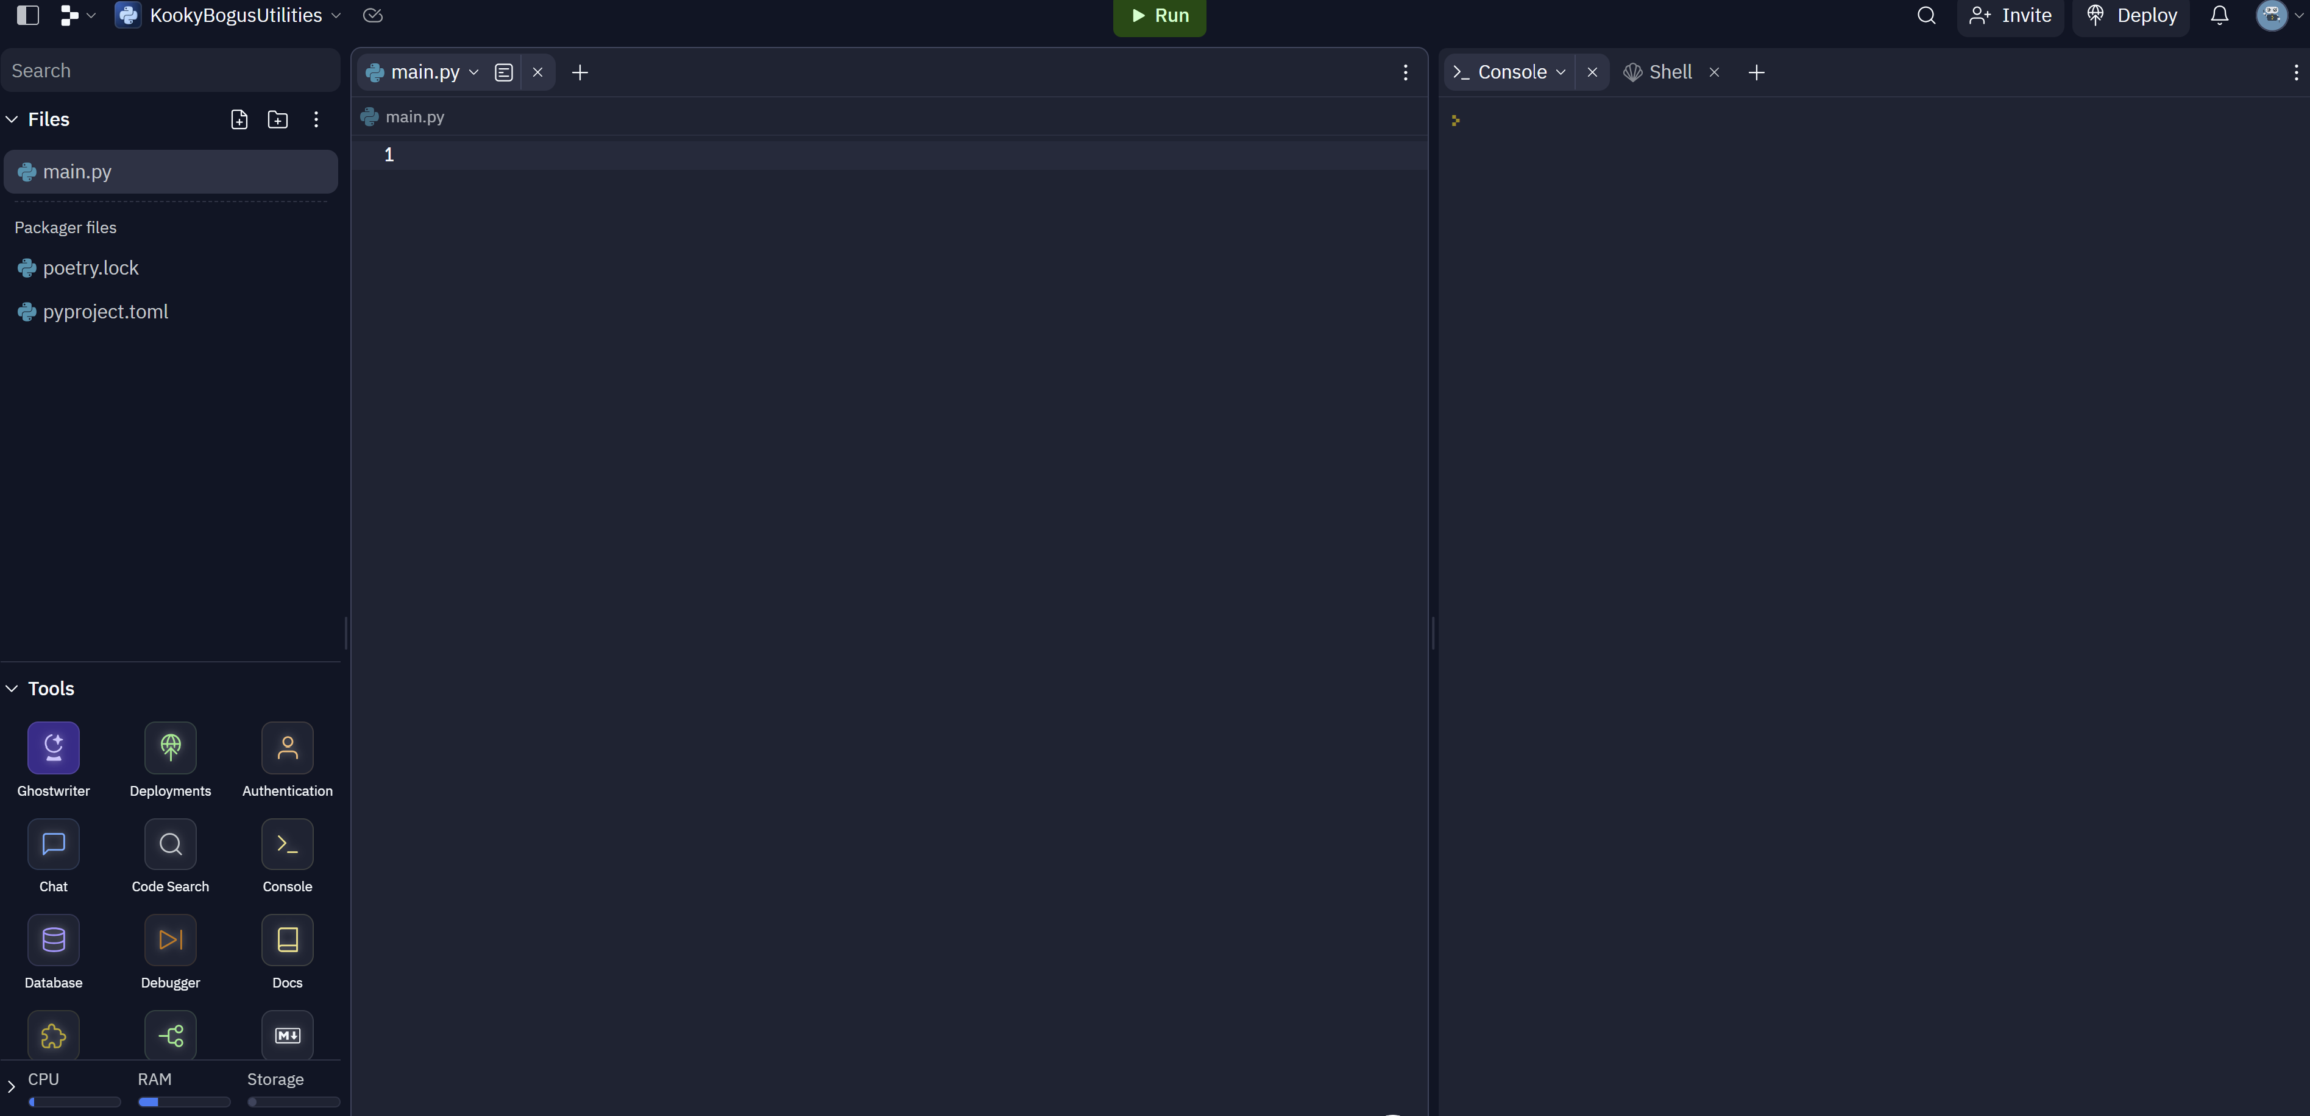
Getting Started with GUI Programming
https://replit.com/

Slide 35
Practical Examples
num_int = 42
print(num_int)
num_int = 44
print(num_int)

Slide 36
Practical Examples
Day=21
Weight=190.4
Temp=-15
print(3+6)
print(day+3)
Print (weight/2)
Print (weight*2)

Slide 37
print("This is an integer:", num_int)
num_float = 3.14
print("This is a floating-point number:", num_float)
text_str = "Hello, Python!"
print("This is a string:", text_str)
is_true = True
print("This is a boolean:", is_true)

Slide 38
Practical Examples
Shirt=“blue”
Print(shirt)
Shirt=‘blue’
Print(shirt)
Store=“mike ’s pizza shop is the “best” there”
Print(store)
Store=‘mike\’s pizza shop is the “best” there’
Print(store)

Slide 39
Practical Examples
Today=21
Month=“October”
Temp=28
Print(“today is 21 October and it’s 28 degrees outside”)
Print(“today is 21 October and it’s 28 degrees outside”)
Print(f“today is {today} {month} and it’s {temp} degrees outside”)

Slide 40
Practical Examples- for next week
Light_is_on=false
If Light_is_on
Print(“the light is On)”
Light_is_on=true
Print(“the light is On)”

